Slide 1
“I have always believed that a role model can be anyone. It’s important for people to realize that young people are always looking at them for guidance, whether that grown person is aware of it or not.”
- Dean Smith, Hall of Fame Coach, UNC
Notes:
Scheduling the Training:
Work with the Athletic Director (AD) or other school administrator to identify a time that works with coaches’ schedules (typically evenings or weekend days).
If possible, have the AD or another coach send a brief description of CBIM to coaches along with an invitation to participate in the training. Coaches are more likely to respond to an invitation from a colleague than from an outside organization.
Training is at least 90 minutes long.
We recommend training groups of no more than 35 coaches at one time. This may mean scheduling multiple training sessions.
As Coaches Arrive – But Before the Training Begins:
Distribute Pre-Season Evaluation surveys for coaches to fill out.
Distribute CBIM Season Planning worksheets for coaches to fill out during the training.
Distribute CBIM Coaches Kits to coaches as they arrive. Ask coaches to wait to open the Coaches Kit until they are instructed to do so.
Have refreshments or more (e.g., lunch/dinner – pizza) available for participants if possible.
CBIM Training Presentation Learning Objectives:
As a result of this training, coaches will be able to:
Describe the value of CBIM as a strong team building tool.
Define and speak about abusive relationship behaviors and healthy relationship skills.
Identify how coaches’ behavior defines their influence as role models to their athletes.
Use CBIM training cards to facilitate athletes’ discussion and reflection on relationships.
Outline the responsibilities required of a coach to run CBIM.

Slide 2
Tell us
Notes:
Time for activity: 10 minutes
Instructional Goals:
This brief introductory activity allows trainers to get a better sense of who’s in the room and helps ground coaches in their motivation and passion for working with young people.
Exercise Logistics:
Have each coach introduce themselves by saying their name and one sentence about why they coach.
For larger groups, you may want to distribute index cards and have coaches write their responses down and give to you to read a few aloud rather than hearing from everyone in the room.
Discussion Points:
Coaches are motivated to do this work by more than just a love of sports. The opportunity to develop relationships with young people – teaching them leadership and character development – is often a big reason why coaches coach.
Coaches can use CBIM as a tool to supplement the work they’re already doing to develop leadership and strong character among their athletes.
Tips for Trainers:
Focus on the terms participants use that relate to relationships (i.e., respect, teaching, character development). Point out that this part of coaching is fairly universal – and it’s the teaching about how to build and maintain healthy relationships that is a core element of CBIM.
This is a tough subject for some to talk about publicly, be prepared for some silence at first. You might want to tell a personal story to open up discussion.

Slide 3
Coaching Boys into Men - Sacramento Program
http://www.youtube.com/watch?v=N8N5emwY-wE
Notes:
Instructional Goals:
This video introduces CBIM through testimonials from coaches and athletes who have participated in the program. Especially if trainers are not athletes or coaches themselves, it can help for coaches to hear from other coaches about the impact of the program right away.
Exercise Logistics:
Before the training begins, make sure to test the internet connection in the room where the training will be held. Have the video queued up and loading on your computer’s internet browser. Video can be found here: https://www.youtube.com/watch?v=N8N5emwY-wE
If you are unable to access the internet during your presentation, email Futures Without Violence staff for the video files OR omit the video from your presentation and send it to coaches via email separately.
Discussion Points:
- Now that you’ve heard from some of the leaders of CBIM, we’ll have a chance to focus on the nuts and bolts of the program, the issues it addresses, and practice how to facilitate CBIM weekly lessons.

Slide 4
What is Coaching Boys into Men?
Builds strong teams and fosters healthy relationships among athletes and their peers
Builds trust and sets expectations for acceptable behavior
Defines abusive behaviors and teaches healthy relationship skills
Leverages coaches’ influence as role models to their athletes
Fits into the sports season
12 “mini-training” lessons just 15 min. discussion per week
Choose any day of the week to conduct the training
Notes:
Time for activity: 2 minutes
Instructional Goals:
As a follow-up to the introductory video, this slide contains some of the details of how CBIM is implemented in schools, as well as how it helps to build strong teams through healthy relationships.
Discussion Points:
CBIM is an evidence-based violence prevention program that equips athletic coaches to talk with their male athletes about the importance of building healthy relationships and that violence never equals strength.
CBIM is most successful when there’s a collaboration between:
______________ Coaches
_______________ School & Athletics Administrators
_______________ Local community org.
Futures Without Violence – a national violence prevention organization that created the program.

Slide 5
Agree, Disagree, Unsure
Notes:
Time for activity: 10 minutes
Instructional Goals:
The main goal for this ADU is to pull out that youth sports is about more than numbers on the scoreboard, wins and losses. Through this activity, coaches explore their influence as role models in the lives of young athletes.
Exercise Logistics:
Explain that this exercise will get coaches up and moving around the room.
Establish one side of the room for “Agree,” and the opposite side of the room for “Disagree.” The mid-point between the two sides is for those who are “Unsure.” Explain that coaches can place themselves anywhere on the continuum, depending on their opinion of the statement.
Read the statement out load and then ask coaches to place themselves in the room, depending on whether they agree, disagree, or are unsure of what they think about the statement.
Discussion Points:
There are many benefits of youth sports – including developing skill in a given sport – and winning is nice. However, you all know that winning games isn’t the only thing that athletes gain from participating in sports. It’s also about the relationships that athletes build with each other and their coaches, and the sense of accomplishment and leadership that can be built throughout the season.
Tips for Trainers:
There are no “right” or “wrong” answers here. ADU statements are intentionally vague. Part of this exercise is helping to develop a safe space for dialogue. Use questions and inquiry to help direct the conversation.
Potential follow-up questions include: How do you think winning has come to be overemphasized in sports? What are some of the consequences of this? How can we address those consequences? As individuals? As institutions?

Slide 6
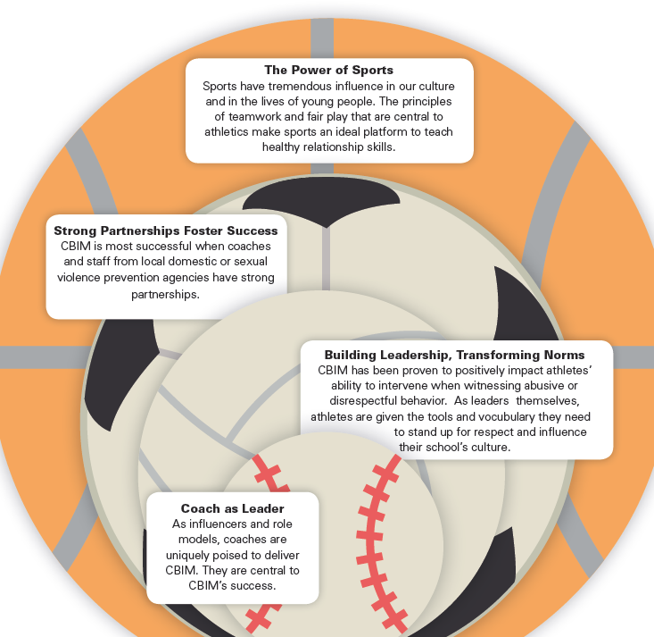
Leveraging the Power of Sports: CBIM Guiding Principals

Slide 7
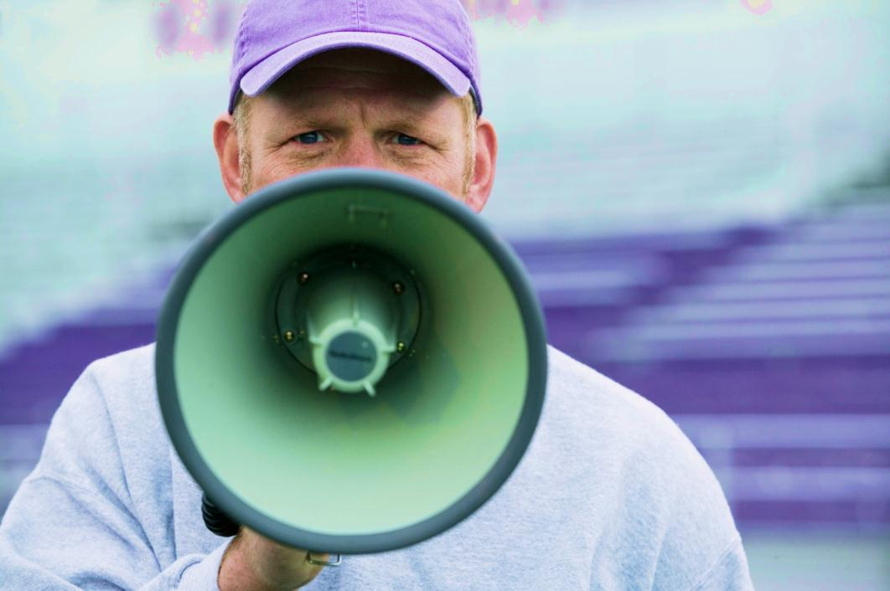
Building Strong Teams
On-field Training
Off-the-field Leadership
COACHES
ARE CRITICAL
Notes:
Instructional Goals:
This slide is an opportunity to follow up on the discussion of the ADU exercise, touching on the key take-away’s that we want coaches to understand.
Discussion Points:
Winning teams require leadership on and off the field/court.
As leaders and role models, coaches are critical in developing leadership among their teams - on and off the field.
Remember when we were introducing ourselves? Many of you already identified the importance of your role as mentors to young athletes as a major reason why you coach.
Youth sports is about more than winning games – it’s about teaching values of selflessness, teamwork, work ethic, integrity, leadership, courage, and respect. These values extend beyond the field and into the daily lives of young athletes. If we’re serious about the importance of youth sports in teaching these values, then we ought to reinforce them and learn how to better pass on those skills.
CBIM is a tool to help coaches develop leadership among their athletes and build stronger teams by fostering healthy relationships.

Slide 8
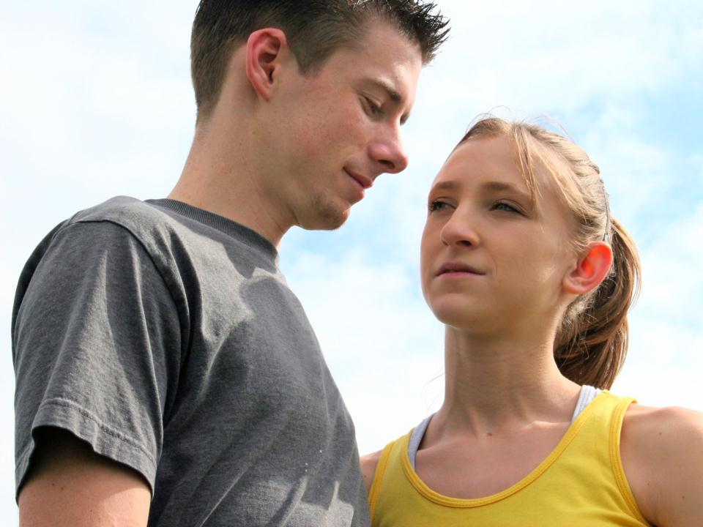
Relationships
Matter
Notes:
Instructional Goals:
This slide helps facilitators to segue from talking about the benefit of youth sports to a more focused discussion on leveraging sports to help youth build healthy relationship skills and know the importance of building healthy teen relationships.
Discussion Points:
In order to help our athletes build healthy relationships and become role models for their peers, we have to first understand what constitutes healthy vs. unhealthy relationship behaviors.

Slide 9
Abusive Relationship Behaviors
Verbal
Physical
Emotional
Sexual
Notes:
Time for activity: 10 minutes
Instructional Goals:
As a result of this exercise, coaches will define abusive and healthy relationship behaviors.
Exercise Logistics:
- Break the coaches into small groups (no more that 8 coaches per group). Assign each group a type of abusive behavior (i.e., physical, emotional, verbal, sexual) and ask them to list/write down examples of that type of abusive behavior. They have 5 minutes for this brief brainstorm.
Each group will then choose a couple examples from their list to share with the large group. (Now coaches open their kits.) As each group shares, facilitators point to the Training Card in the CBIM Card Series that corresponds to those behaviors.
Highlight Training Card 6 for sexually abusive behaviors; Training Card 4 for verbally abusive behaviors; Training Card 4 and 7 for emotionally abusive behaviors; and Training Card 8 for physically abusive behaviors.
Discussion Points:
Focus on power and control as the objective of these behaviors. Ask participants: “Why would someone behave this way toward their partner?”
In an abusive or violent relationship, power and control are repeatedly misused against a girlfriend, boyfriend, family member or peer. All of these behaviors can be used by an abusive partner to gain or maintain power and control over someone else.
Connect the intent with the effect of the behavior on the abused partner. Ask participants: “What do you think the effect of this behavior is? How do you think it would make someone feel?”
Ask participants: “Why do you think it’s important to understand these behaviors, their likely intention and their impact?”
Focus on the importance of determining consent in order to distinguish between respectful, healthy relationship behaviors and unhealthy and abusive behaviors. Ask participants: “How do you know the difference between a respectful behavior and a potentially harmful and disrespectful behavior?” For some people, a hug is a perfectly acceptable way to greet someone. But for others, a hug is unwanted and can even feel threatening. How do you know the difference? You have to ASK permission and then respect boundaries when they are communicated.
Tips for Trainers:
-If you’re less familiar with the issue of teen dating violence, familiarize yourself with the power and control wheel prior to facilitating the Coaching Boys into Men training: http://lessonsfromliterature.org/docs/manual/Power_and_Control_Wheel.pdf.
If you’re running low on time, facilitate this activity as a large group brainstorm rather than breaking into small groups.

Slide 10
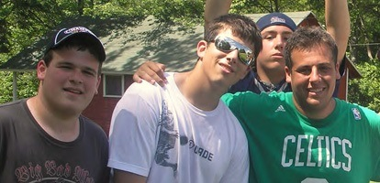
Healthy Relationship Behaviors
Verbal
Physical
Emotional
Sexual
Notes:
Time for activity: 10 minutes
Instructional Goals:
As a result of this exercise, coaches will define abusive and healthy relationship behaviors.
Exercise Logistics:
Have coaches return to their small groups to brainstorm behaviors that define a healthy relationship in their assigned categories (i.e., physical, emotional, verbal, or sexual).
Explain that only affirmative behaviors are allowed (e.g., “not hitting” doesn’t count as a physically healthy relationship behavior).
Each group will then share a few examples of behaviors from their list with the large group.
Facilitators highlight Training Cards 10 and 11 that both promote healthy relationship behaviors.
Discussion Points:
Why would we do this particular exercise? Healthy relationships are typically more difficult to define.
Healthy behaviors are based on equality and build communication and mutual respect.
How do young people learn about relationship behaviors? From role models and important adults in their lives like you.
Treating others how they want to be treated is the key to healthy and respectful relationship behaviors. For example, just because hugging is okay for one person doesn’t mean that behavior will feel respectful to everyone.
If ever you’re feeling unsure whether a certain behavior is okay or not, ASK the other person what they feel comfortable with.
Tips for Trainers:
Make sure to distinguish what makes healthy relationship behaviors respectful (i.e., not assuming/accepting “giving hugs” is a respectful behavior simply because they’re hugs). The key is to ask folks to think about the impact of their behavior.
Emphasize the importance of asking for consent to determine whether a behavior is respectful and healthy or not.

Slide 11
Impacts
Teens experiencing dating violence are more likely to:
Engage in risky sexual behaviors
Smoke
Use drugs
Consider or attempt suicide
Have unhealthy diet behaviors
Do poorly in school
1 in 3 teens reports knowing a friend or peer who has been physically hurt by a partner, but many of them don’t know what do.
Notes:
Time for activity: 5 minutes
Instructional Goals:
In describing the consequences and prevalence of dating violence, coaches understand how this issue affects young athletes on their team.
Discussion Points:
- Relationship abuse affects young people particularly in ways you might not know or imagined.
- Giving teens the confidence, language, and support to stand up against abuse is critical to building leadership and fostering respect.

Slide 12
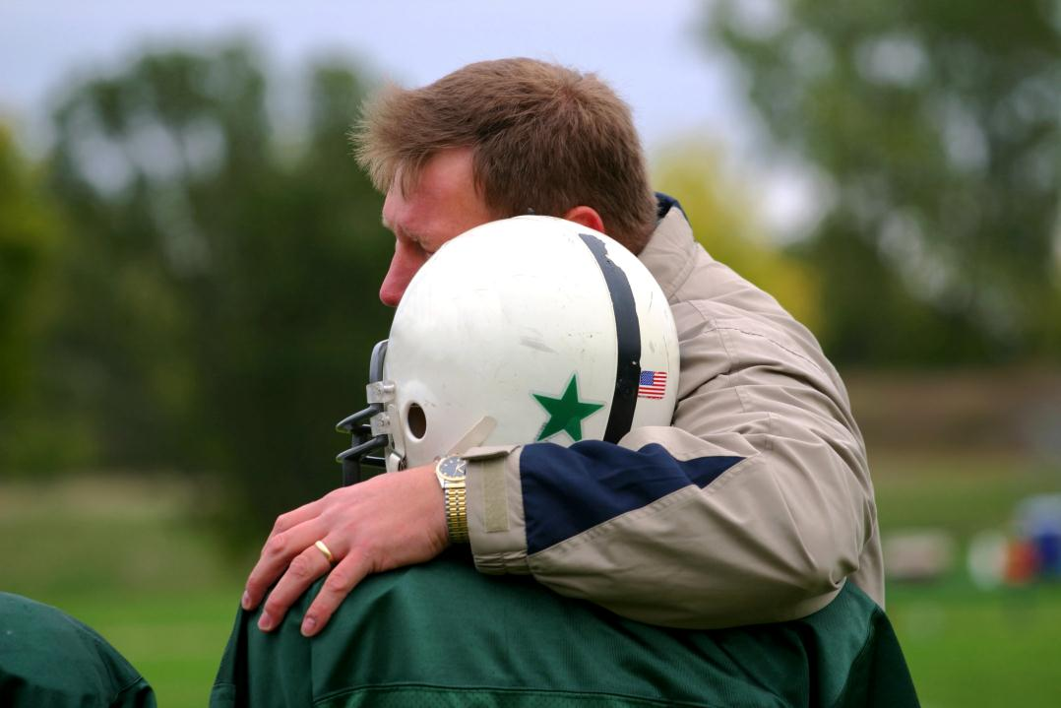
Everybody Needs Somebody
Notes:
Instructional goals:
This slide serves as a segue to talking more concretely about CBIM as a leadership opportunity for coaches. They can be that “somebody” who changes the life trajectory for a young man.
Discussion Points:
Coaches are important role models in the lives of young athletes. If you stand for something positive, you have an opportunity to make a world of difference for your athletes and the school community to which you all belong.
Hurt people hurt people. Perpetrators of dating violence and bullying are more likely to have been exposed to some kind of violence and abuse themselves. If given the guidance and support they need, young people can learn healthy and respectful ways of behaving in relationships.

Slide 13
It starts with you
Coaches
Players & Teams
Schools & Communities
Coaches’ actions and behaviors affect their players, teams, schools, and communities.
Notes:
Instructional Goals:
Coaches will explore the ripple effect their influence and leadership has on their athletes and others.
Discussion Points:
Coaches have a wide scope of influence! You know that athletes are receiving all kinds of messages about relationships from their peers, the media, etc. , relationships.
The expectations you set for your athletes will affect not only your team but will also be seen and noticed throughout your school and community. As athletes, these students will typically be the leaders in the school; athletes on your team will become role models for respect in their own right.

Slide 14
CBIM Champions – South Portland Red Riots
Notes:
Time for activity: 3 minutes
Instructional Goals:
This video provides more testimonials from coaches and athletes who have participated in CBIM.
Exercise Logistics:
- Have this video loading on your computer’s internet browser. Video can be found online here: https://www.youtube.com/watch?v=kzmQwY6JFLY- If
Tips for Trainers:
- If running low on time, skip this slide and send coaches a link to view the video after the training presentation.

Slide 15
Leadership Program
Notes:
Instructional goals:
This slide introduces the next section, which delves further into the specifics of the CBIM program as a leadership opportunity for coaches and their athletes.

Slide 16
Responsibilities of a CBIM Coach
Notes:
Time for activity: 10 minutes
Instructional Goals:
Coaches will understand the sequence of tasks and responsibilities required of them to implement CBIM.
Exercise Logistics:
Have coaches take out their CBIM Card Series from the Coaches Kit and turn to Prep Card 3, “Lead Brief Weekly CBIM Trainings.”
Ask for volunteers to take turns reading each paragraph Prep Card 3 out loud to the group. (Have a different coach read each of the paragraphs.)
Discussion Points:
We don’t expect coaches to become social workers or experts on this issue overnight. You’ve seen from the structure of the Training Cards that the curriculum is designed to be straightforward.
If you need to read directly from the scripted language on the Training Cards, that’s okay. We encourage you to do what feels comfortable for you and your team. The goal is to have coaches put in their own voice eventually.

Slide 17
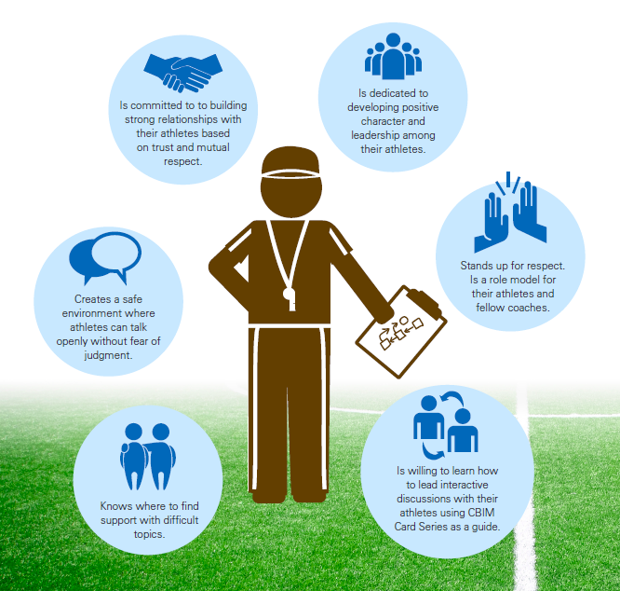
CBIM Coach Characteristics
Notes:
Videos
Posters
Brochures
CBIM Spotlight Toolkit
Making the Case – FAQs
Evaluation Journal Articles
Program Evaluation Tools
Coaches’ Clinic Presentation
Coaches’ Clinic Lesson Plan
Season Planning Worksheet for Coaches
Coaches’ Clinic – FAQs
CBIM Licensing Agreement
International Playbook
Progress Reports
Community Assesment

Slide 18
Responsibilities of a CBIM Coach
PRE-SEASON
• Attend Coaches Training
• Identify a day/time for weekly lessons
• Pre-season Survey for Athletes
Notes:
Instructional Goals:
Coaches will understand the sequence of tasks and responsibilities required of them to implement CBIM during pre-season.
Exercise Logistics:
Have coaches take out their “CBIM Season Planning” worksheet and fill in the date they plan to begin implementing CBIM, as well as the consistent weekly time they think will work best for their team to facilitate CBIM lessons.
Explain that the CBIM champion/advocate will schedule time to come to practice to administer the pre-season evaluation survey for athletes prior to their start date for CBIM.
Discussion Points:
We’ve worked with a lot of coaches and each of them finds the unique way that CBIM works for their team.
Many coaches report that setting a consistent weekly time aside for CBIM lessons helps them to stay on track.
The CBIM champion you’re working with will help to administer the confidential evaluation of the program in your school. The evaluation survey you filled out at the beginning of the training is part of our efforts to measure what has changed on your team as a result of CBIM and how we can improve the program in the future. If you have questions about the evaluation and how it will be used, your CBIM liaison/contact can answer those.

Slide 19
Responsibilities of a CBIM Coach
PRE-SEASON
• Attend Coaches Training
• Identify a day and time for weekly CBIM lessons
• Pre-season Survey for Athletes
DURING SEASON
• Facilitate weekly Trainings (15-20 min.)
• Address Teachable Moments
• Communication with CBIM Staff
Notes:
Instructional Goals:
Coaches will understand the sequence of tasks and responsibilities required of them to implement CBIM during the season.
Exercise Logistics:
- Have coaches fill in their preferred method of communication on the “CBIM Season Planning” worksheet.
Discussion Points:
Communication with CBIM staff is key. We don’t expect coaches to be experts as a result of this brief training but you know your players best and we want to support you.
We know that questions and possibly difficult situations may come up. We’re here to help you. Expect to be in touch with the CBIM champion in your community regularly. Their job is to support you and your team in implementing CBIM. You’re not alone.

Slide 20
Responsibilities of a CBIM Coach
POST-SEASON
• Post-Season Survey for Athletes
and coaches
• Attend brief wrap-up meeting with CBIM Staff
PRE-SEASON
• Attend Coaches Training
• Identify a day and time for weekly CBIM lessons
• Pre-season Survey for Athletes
DURING SEASON
• Facilitate weekly Trainings (15-20 min.)
• Address Teachable Moments
• Regular communication with CBIM Champion
Notes:
Instructional Goals:
Coaches will understand the sequence of tasks and responsibilities required of them to implement CBIM post-season.
Discussion Points:
- The CBIM champion you’re working with will help to administer a confidential evaluation of the program in your school. At the end of the season, they will schedule time to administer a confidential post-season survey. They will also provide you with information on the results of the evaluation and feedback on your implementation of CBIM.

Slide 21
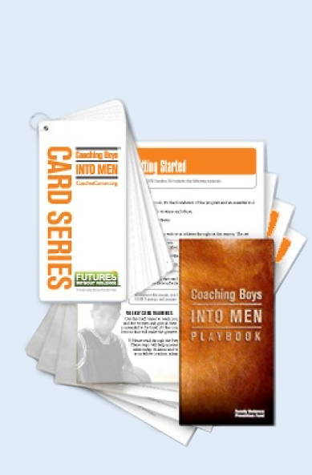
The CBIM Coaches Kit
CBIM Playbook
Introduction to the issue
Capitalize on “Teachable Moments”
CBIM CARD SERIES
Messages in 15-20 min talks/week
References & Resources
Assists coaches during implementation
CBIM Overview, referral information
Notes:
Time for activity: 2 minutes
Instructional Goals:
Introduce the CBIM Coaches Kit materials.
Discussion Points:
There are three main sections/items in the kit as described on the slide.
Tips for Trainers:
- As you review the contents of the CBIM Coaches Kit, have coaches take each piece out of their Kit and briefly review it so they will be able to identify it for future use.

Slide 22
The CBIM Card Series
Prep Cards (5)
Help you prepare for CBIM during the season
Training Cards (12)
Outline the delivery of weekly discussions
Halftime & Overtime Cards (3)
Strategies to engage your school and community in CBIM
Notes:
Time for activity: 5 minutes
Instructional Goals:
Introduce the structure and format of the CBIM Card Series.
Discussion Points:
The training cards are the anchor of the program and designed like a Lesson or Practice Plan. They lay out a map for you to follow in leading weekly discussions. You can follow them word for word and or rephrase them to make it your own and speak more personally to the lives and experiences of you and your athletes.
In addition to weekly lessons, the Card Series includes three Prep Cards to help you prepare for the season and Halftime and Overtime Cards to showcase your team’s leadership and commitment to respect and non-violence; these give optional ways to more explicitly engage with others not on the team.

Slide 23
Training Topics
Pre-Season Speech
Personal Responsibility
Insulting Language
Disrespectful Behavior Towards Women & Girls
Digital Disrespect
Understanding Consent
Notes:
Instructional Goals:
Introduce the sequence of training topics covered in the CBIM Card Series.
Tips for Trainers:
- Have coaches read aloud the title of each weekly lesson.

Slide 24
Training Topics (cont.)
Bragging About Sexual Reputation
When Aggression Crosses the Line
There’s No Excuse for Relationship Abuse
Communicating Boundaries
Modeling Respect and Promoting Equality
Signing the CBIM Pledge
Notes:
Instructional Goals:
Introduce the sequence of training topics covered in the CBIM Card Series.
Tips for Trainers:
- Have coaches read aloud the title of each weekly lesson.

Slide 25
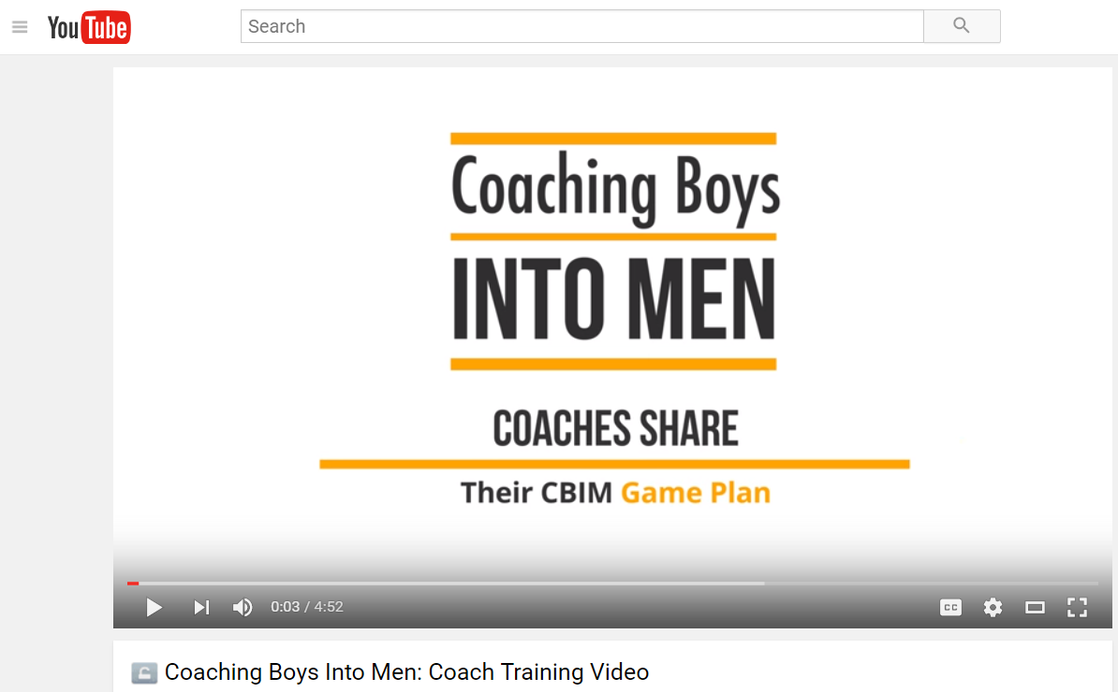
Coach Delivery Training Video

Slide 26
CBIM Game Plan
Use Your Unique Coaching Style
Encourage Athlete Participation
Team-up for Tough Topic
Notes:
The following tips from coaches like you will help build your CBIM game plan.
TIP 1: USE YOUR UNIQUE COACHING STYLE
Put the Training Card messages into your own words – Your athletes are used to hearing your voice and will respond to that. Before trying to put a Training Card into your own words, make sure you’ve read the Card and understand the key messages. Once you feel comfortable with the Card, you can use it as a guide for facilitating conversation with your athletes.
Tell stories to emphasize key messages – Whether it’s an example from your own life, pop culture, or a recent incident in your school, athletes tend to remember CBIM Training Cards better when coaches tell stories to illustrate key messages. Be careful not to let your stories distract from the main messages of each Training Card. If you’re unsure whether a specific example is appropriate, ask the CBIM Advocate in your community or try your story out on a colleague before presenting it to your team.
TIP 2: ENCOURAGE ATHLETE PARTICIPATION
Rather than lecturing to your team, CBIM Training Cards should be interactive. Ask open-ended questions to encourage discussion. If you’re unsure about something an athlete said, ask them to clarify or ask a follow-up question until you understand what they’re trying to say.
If you don’t know the answer to an athlete’s question, it’s okay to say that you’re not sure. Write down their question and follow up with the CBIM Advocate for support.
TIP 3: TEAM UP FOR TOUGH TOPICS
Coaches say that Training Cards covering sensitive issues like consent or bragging about sexual reputation can be intimidating. Consider inviting the CBIM Advocate, school counselor or other expert to deliver these Cards with you, or ask them to coach you on how to talk about these issues with your athletes.

Slide 27
Practice
Notes:
Time for activity: 10 minutes
Instructional Goals:
Provide coaches with opportunities to use the CBIM Coaches Kit materials to facilitate discussion and address teachable moment scenarios.
Exercise Logistics:
In this section, facilitators will role play a successful CBIM weekly lesson using the Digital Disrespect Training Card (i.e., one person plays coach while others are athletes listening and asking relevant questions).
Use the following slides to highlight how each section of the Training Cards should be used by coaches to effectively facilitate conversation.
Tips for Trainers:
- If there aren’t enough facilitators to fill the roles of coach and several athletes, ask for training participants to volunteer to play the role of athletes.

Slide 28
Training Cards
Notes:
Instructional Goals:
Introduce the structure and format of the Training Cards, as well as provide tips for coaches on how to use the Training Cards to facilitate a successful discussion with athletes.
Exercise Logistics:
- The facilitator who is playing the role of the coach reads out loud the learning objectives listed on the Digital Disrespect Training Card, explaining that this should be done in advance of the scheduled weekly CBIM lesson so the coach familiarizes himself with the lesson’s expectations.
Discussion Points:
- Each Training Card begins with this section. The goal of this section is to orient you and help you prepare to lead the training.
Lesson Prep – It’s good to review the central concepts in advance of each week’s CBIM lesson. If you have questions or feel unsure about any of the content, connect with other coaches or the CBIM liaison/contact for support.
Read the learning objectives listed on the Training Card to identify the main goals/objectives and what you want your athletes to take away from the discussion.

Slide 29
Training Cards (cont.)
Notes:
Instructional Goals:
Introduce the structure and format of the Training Cards, as well as provide tips on how to use the Training Cards to facilitate a successful discussion with athletes.
Exercise Logistics:
Facilitators role-play reading the Warm Up speech from the Digital Disrespect Training Card to a team.
Take this opportunity to model facilitation, putting the Warm Up speech into the coach’s own words.
Discussion Points:
Why do you start practice with a warm up? In order to get athletes prepared/ready to participate fully and safely. This part of the Training Card is designed to introduce athletes to the weekly topic.
It’s helpful to read the Warm Up speech in advance of the weekly CBIM lesson to familiarize yourself with the content.
It’s up to you to decide whether you want to read the Warm Up speech directly from the Training Card or tailor it to your own style. Whatever makes you feel most comfortable.

Slide 30
Training Cards (cont.)
Notes:
Instructional Goals:
Introduce the structure and format of the Training Cards, as well as provide tips on how to use the Training Cards to facilitate a successful discussion with athletes.
Exercise Logistics:
Facilitators role-play using the Ask the Players from the Digital Disrespect Training Card as a guide for discussion with athletes.
Again, this is an opportunity to model facilitation skills, asking follow-up questions and mirroring back what the coach has heard from his “athletes”.
Discussion Points:
This is where most of the learning and development happens. It is like running drills or practicing plays. Gives athletes a chance to work though the information or skills for themselves.
This is the part of CBIM lessons that may take practice before it feels comfortable. It’s important that CBIM lessons aren’t just a lecture delivered to the athletes. Instead, they should be more like a conversation that you guide, using the Ask the Players section of the Training Cards as your tool.
Ask open ended questions- Not ones that can be answered with a simple “yes” or “no”. They are meant to solicit thoughtful responses from your athletes. If you’re unsure about something an athlete said, ask them to clarify or ask a follow-up question until you understand what they’re trying to say.
Repeat back what you think you hear athletes say to clarify and make sure you understand and captured the meaning correctly.
If you don’t know the answer to an athlete’s question, it’s okay to say that you aren’t sure. Write down their question and follow up with the CBIM liaison/contact for support.

Slide 31
Training Cards (cont.)
Notes:
Instructional Goals:
Introduce the structure and format of the Training Cards, as well as provide tips on how to use the Training Cards to facilitate a successful discussion with athletes.
Exercise Logistics:
- Facilitators role-play the Discussion Points & Wrap Up section of the Digital Disrespect Training Card. Take this opportunity to model how coaches can put the script from the Training Cards into their own words, or read directly from the Card.
Discussion Points:
This is like the final huddle in practice. Recapping what you did, what you are still working on, and looking ahead to the next game.
Summarizing- Restate key points from the discussion to highlight objectives and offer a chance to conclude with expectations for respectful behaviors from now on.
Similar to the Warm Up speech, you can choose whether to read directly from the Training Card or to put the Discussion Points & Wrap Up in your own words.

Slide 32
Practice
Notes:
Time for activity: 10 minutes
Instructional Goals:
Provide coaches with another opportunity to practice using the Card Series to facilitate discussion with their athletes.
Exercise Logistics:
In small groups coaches select any of the lessons in the Card Series to practice facilitating.
Each coach is assigned one section of the Training Card to facilitate. One coach reads the learning objectives aloud, another coach reads the Warm Up speech aloud, one coach facilitates a discussion using the Ask the Players section, and finally – another coach concludes the discussion using the Discussion Points & Wrap Up.
Discussion Points:
It’s okay if you feel a little uncomfortable at first. With time and practice, you will find your own style that fits your personality and that of your athletes.
Remember that it’s okay to read directly from the Training Card if that feels most comfortable to you.

Slide 33
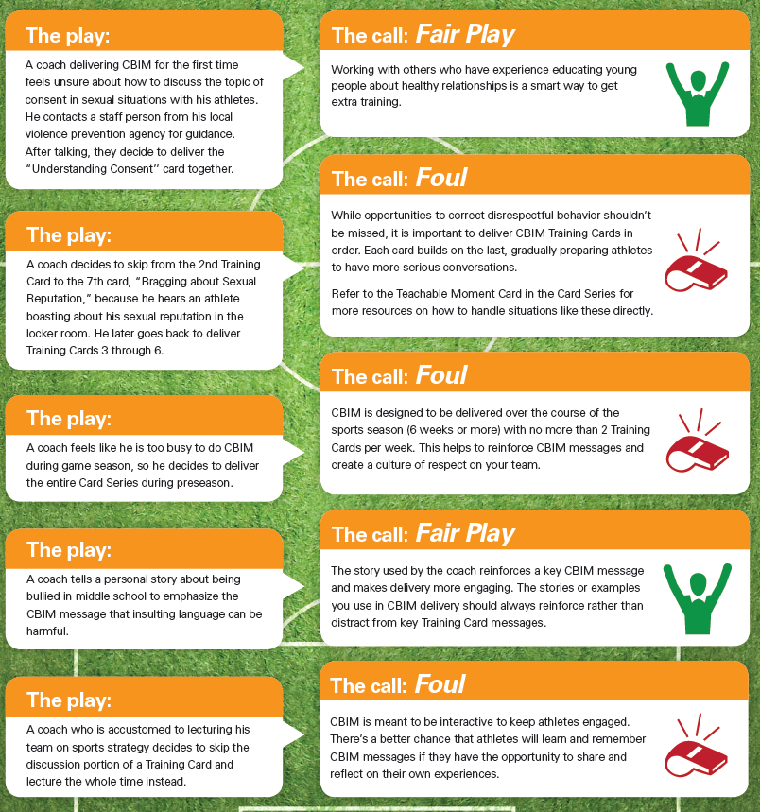
Fair or Foul Play?
Notes:
Each coach and coaching style is unique and the same is true for how CBIM
Training Cards are delivered. CBIM should be tailored to fit your unique
coaching style. There are a few things, however, that shouldn’t be changed.
These real world examples from coaches who have delivered CBIM can
help you understand what’s in and out of bounds when it comes to CBIM.
The situations below are only a few of the most common adaptations in
the field. If you have a question about an adaptation in your community
please reference the Adaptation Guidelines document, or email us at
coachescorner@futureswithoutviolence.org.

Slide 34
Fair or Foul Play?
Notes:
Each coach and coaching style is unique and the same is true for how CBIM
Training Cards are delivered. CBIM should be tailored to fit your unique
coaching style. There are a few things, however, that shouldn’t be changed.
These real world examples from coaches who have delivered CBIM can
help you understand what’s in and out of bounds when it comes to CBIM.
The situations below are only a few of the most common adaptations in
the field. If you have a question about an adaptation in your community
please reference the Adaptation Guidelines document, or email us at
coachescorner@futureswithoutviolence.org.

Slide 35
Teachable Moments
What are they?
Notes:
Time for activity: 8 minutes
Instructional Goals:
Define the importance of teachable moments to the CBIM philosophy and program.
Exercise Logistics:
- Have coaches turn to page 26 in their CBIM Playbooks and take turns reading the “Locker Room Chatter” scenario out loud to the group.
- Define Teachable moments as opportunities to highlight abusive relationship behaviors or healthy relationship skills exhibited by your athletes and/or events in the media.
Discussion Points:
- Being aware of your athletes’ behavior and current events to address abusive relationship behaviors and promote healthy relationship skills is an important part of the CBIM program. Taking advantage of teachable moments will reinforce the weekly lessons and help athletes understand your commitment to these issues.
Tips for Trainers:
- If running low on time, skip the Teachable Moment slides and go straight to the final wrap-up slide. Provide more information on responding to teachable moments in your communication with coaches after the training.

Slide 36
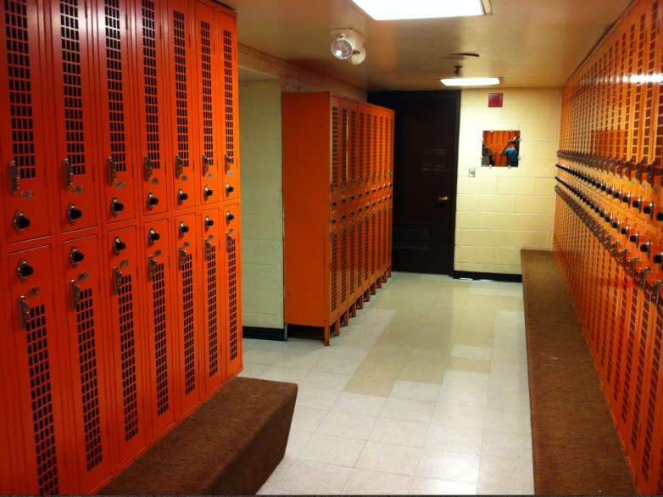
What do you do?
“Locker Room Chatter” Teachable Moment
Notes:
Instructional Goals:
Define the importance of teachable moments to the CBIM philosophy and program.
Exercise Logistics:
Solicit responses from coaches about what they would do to respond to the “Locker Room Chatter” teachable moment scenario.
Refer to Training Card 7 in the Card Series that addresses bragging about sexual reputation. If time allows, ask volunteers to read from the Discussion Points & Wrap Up for more ideas on how to address this teachable moment.
Refer to the Teachable Moment card in the Card Series, highlighting it as another tool for coaches to refer to when teachable moments happen.
Discussion Points:
It’s important to respond to disrespectful or inappropriate behavior when you see/hear it. Refer to the Card Series and the Playbook for guidance on how to respond to teachable moments.
If you need further help or resources for how to handle a situation, talk with the CBIM liaison/contact for more support.

Slide 37
Thank you!
For more info – go to:
www.CoachesCorner.org
Notes:
Instructional Goals:
Conclude the training with next steps in your CBIM implementation.
Exercise Logistics:
Collect the “CBIM Season Planning” worksheets from coaches.
Reiterate any next steps for CBIM implementation in your community.
Make sure to add your personal contact information to this slide so coaches know how to contact you.

